Slide 1
Chapter 2. Numerical methods for matrices

Slide 2
Numerical methods for matrices
Matrices in physics
Basic matrix operations
Linear equation systems
Matrix decomposition
Eigenvalue problems

Slide 3
Many problems in physics can be formulated in a matrix form
Q: Where is matrix?
A: Matrices are everywhere in physics!
An eigenvalue problem given in the form of a partial differential equation can be rewritten as a matrix problem.
A boundary-value problem after discretization is essentially a linear algebra problem.
The vibrational spectrum of a molecule with n vibrational degrees of freedom can be also solved using matrix methods.

Slide 4
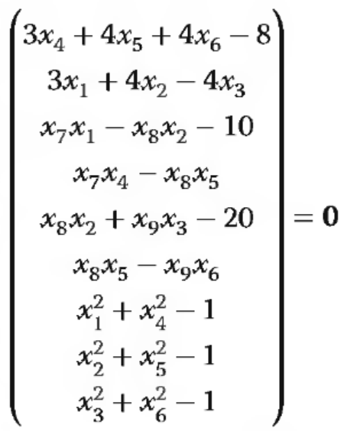
Newton-Raphson for Root: multiple variables

Slide 5
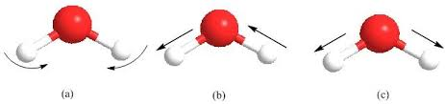
Vibration of a Molecule
Elastic energy
Kinetic energy
Lagrange equation
L=T-U

Slide 6
Let:
The determinant
The roots of this secular equation, λ_{k} with k = 1, 2, . . . , n, give all the possible vibrational angular frequencies ω_{k}²=λ_{k} of the molecule.

Slide 7
Kirchhoff Equations for Circuits
The unbalanced Wheatstone bridge
i₂
i₃
Ohm's law
i₂-i₃
i₁-i₃
i₁-i₂
i₁

Slide 8
Matrix Quantum Mechanics
Choosing a set of bases: orthogonal, complete, unitary.
Then the Hamiltonian can be written as a matrix with the elements as:
The Schrodinger equation
In fact, any operators can be written as matrices.
For example: The spin -1/2 electron. Bases: spin up: |↑>; spin down: |↓>

Slide 9
Introduction to matrix
Definition of a matrix
A variable array x with elements x₁, x₂, . . . , x_{n} arranged into a column is viewed as an n × 1 matrix, or an n-element column matrix.

Slide 10
Types of Matrices
square matrix: # of rows = # of columns
upper triangular matrix strictly upper triangular matrix

Slide 11
lower triangular matrix strictly lower triangular matrix
diagonal matrix

Slide 12
banded matrix
a square matrix with elements of zero except for the principal diagonal and values in the positions adjacent to the diagonal.
tridiagonal matrix

Slide 13
unit matrix: 1 on the principal diagonal
null matrix: All elements are zero.

Slide 14
symmetric matrix:
a square matrix in which
skew-symmetric matrix:
a square matrix in which for all i and j

Slide 15
Matrix Operations
Matrix equality
Matrix addition and subtraction
C = A + B = B + A (commutative)
C = A - B

Slide 16
Example: Matrix addition and subtraction

Slide 17
Matrix Multiplication
# of columns in A = # of rows in B
# of rows in C = # of rows in A
# of columns in C = # of columns in B

Slide 18
5. Matrix multiplication is not commutative
6. Matrix multiplication is associative

Slide 19
Example: Matrix Multiplication

Slide 20
Matrix Multiplication by a Scalar
An example:

Slide 21
transpose of matrix A: A^{T}
(A^{T}) ^{T} = A

Slide 22
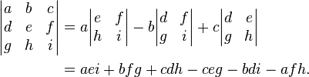
Determinant
The determinant of an n x n matrix A is defined as:
for any j = 1, 2, . . . , n, where |R_{ij}| is the determinant of the residual matrix R_{ij} of A with its ith row and jth column removed.
C_{ij}=(-1)^{i+j}|R_{ij}| is called a cofactor of A_{ij}.

Slide 23
Inverse of A
The inverse of a square matrix A (written as A⁻¹) is defined by
where I is a unit matrix with the elements I_{ij}=δ_{ij}.
In principle, the inverse of A can be obtained through
If a matrix has an inverse or nonzero determinant, it is called a nonsingular matrix.
Otherwise, it is a singular matrix.

Slide 24
Trace of a matrix A is the sum of all its diagonal elements, written as
Transpose of a matrix A (written as A^{T})
Orthogonal matrix: A^{T} = A⁻¹.
Hermitian operation of A: complex conjugate of A^{T} written as A† (or A^{H}) with A†_{ij}= A*_{ji} .
Hermitian matrix: A†=A
Unitary matrix: A†=A⁻¹

Slide 25
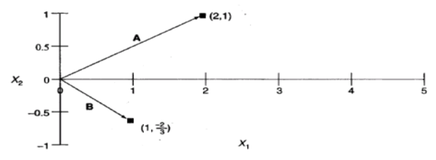
Vectors
Column vector
Row vector
Vectors of two ordinates

Slide 26
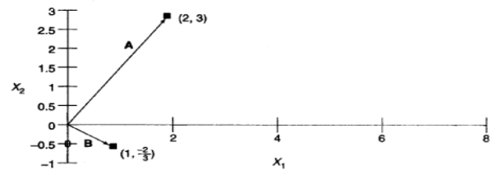
orthogonal vectors
Two vectors are said to be orthogonal if their product is equal to zero.
If two vector are orthogonal, they are perpendicular to each other in the n-dimensional space.

Slide 27
normalized vectors
A vector is normalized by dividing each element by its length.
A normalized vector has a length 1.
Two vectors that are both normalized and orthogonal to each other are said to be orthonormal vectors.

Slide 28
Example: Vectors

Slide 29
Normalized vectors:

Slide 30
Rank of A Matrix
A matrix of r rows and c columns is said to be of order r by c. If it is a square matrix, r by r, then the matrix is of order r.
The rank of a matrix equals the order of highest-order nonsingular submatrix.
The rank of a matrix is the dimension of the vector space generated (or spanned) by its columns or rows.

Slide 31
Example 1: Rank of Matrix
3 square submatrices:
Each of these has a determinant of 0, so the rank is less than 2. Thus the rank of R is 1.

Slide 32
Example 2: Rank of Matrix
Since |A|=0, the rank is not 3. The following submatrix has a nonzero determinant:
Thus, the rank of A is 2.

Slide 33
Linear equations
a_{ij} : known coefficient
X_{j} : unknown variable
C_{i} : known constant
Assume # of unknowns = # of equations
Assume the equations are linearly independent; that is, any one equation is not a linear combination of any of the other equations.

Slide 34
The linear system can be written in a matrix-vector form:
|A|≠0 ----> a unique solution
Combining A and C, it can be expressed as:

Slide 35
can be expressed as:

Slide 36
Solution of Two Equations
It can be solved by substitution.
With substitution, we get

Slide 37
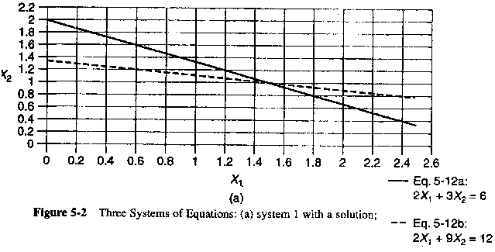
Classification of Systems of Equations
Systems that have unique solutions

Slide 38
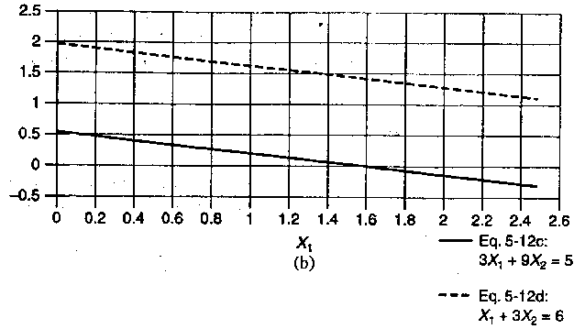
Systems without solutions (parallel lines)

Slide 39
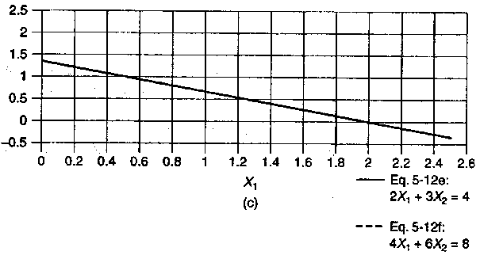
Systems with an infinite number of solutions (same line)

Slide 40
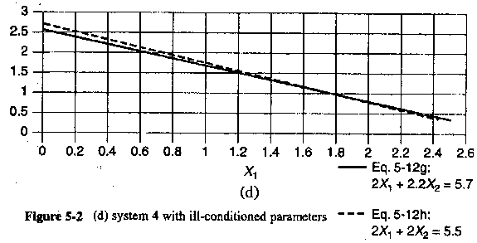
A system that has a solution, but has ill-conditioned parameters.

Slide 41
Permissible Operations
Rule 1: The solution is not changed if the order of the equations is changed.

Slide 42
Rule 2: Any one of the equations can be multiplied or divided by a nonzero constant without changing the solution.
Rule 3: The solution is not changed if two equations are added together and the resulting equation replaces either of the two original equations.

Slide 43
Gaussian elimination for linear equation systems
Gaussian
elimination
Coefficient
matrix A⁽⁰⁾ & b⁽⁰⁾
intermediate matrix
A^{(j)} & b^{(j)}
backward substitutions
roots of
equations
triangular matrix
The inverse and the determinant of a matrix can also be obtained in such a manner.

Slide 44
multiply the first equation by
-A_{i1}⁽⁰⁾ /A₁₁⁽⁰⁾
multiply the second equation by
-A_{i2}⁽¹⁾ /A₂₂⁽¹⁾
add it to the ith equation for i > 1
add it to the ith equation for i > 2

Slide 45
continued with the third,fourth, . . . , and (n-1)th equations
Then the coefficient matrix becomes an upper-triangular matrix A^{(n-1)}.
A linear equation set with an upper-triangular
coefficient matrix can easily be solved with backward substitutions.

Slide 46
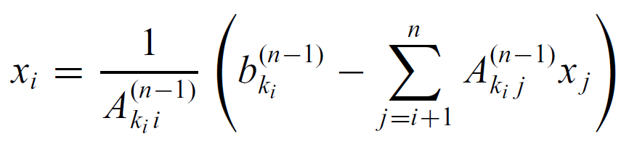
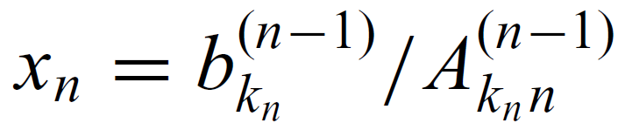
Solution of a linear equation set
After the Gaussian elimination, the solution of a linear equation set is then obtained through backward substitutions with
for i = n-1, n-2, . . . , 1, starting with

Slide 47
Example: Gaussian Elimination Procedure
Represented in the matrix form:

Slide 48
As the step 1 in the forward pass, we will convert the element a₁₁ (a₁₁ is called the pivot for row 1) to 1 and eliminate, that is set to zero, all the other elements in the first column.

Slide 49
Step 2:
Step 3:

Slide 50
Step 4:
It represents:

Slide 51
Step 1 of backward substitution:
Step 2:

Slide 52
Step 3:
The solution is:
X₁ = 1, X₂ = 2, X₃ = 3, X₄ = 4

Slide 53
pivoting
Because all the diagonal elements are used in the denominators, the scheme would fail if any of them happened to be zero or a very small quantity.
This problem can be circumvented in most cases by interchanging the rows to have the elements used for divisions being the ones with largest magnitudes possible.
This is the so-called pivoting procedure.
This procedure will not change the solutions of the linear equation set.

Slide 54
The partial-pivoting scheme, which searches for the pivoting element only from the remaining elements of the given column.
We first search for the element with the largest magnitude from |A_{i1}⁽⁰⁾| for i = 1, 2, . . . , n.
Assuming that the element obtained is A_{k11}⁽⁰⁾, we then interchange the first row and the k₁th row and eliminate the first element of each row except the first row.
Similarly, we can search for the second pivoting element with the largest magnitude from |A_{i2}⁽¹⁾| for i = 2, 3, . . . , n.

Slide 55
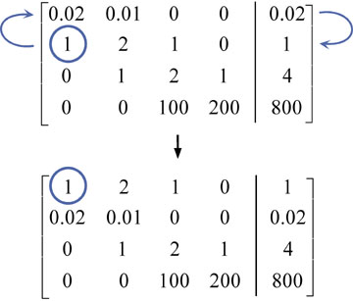
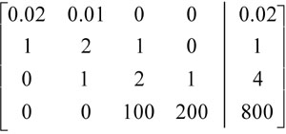
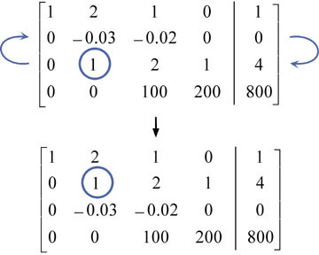
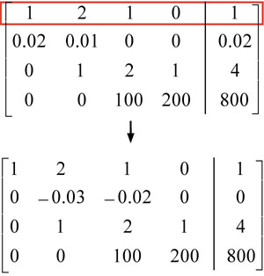
Example: Gaussian Elimination with Partial Pivoting
…

Slide 56
Code example
GaussianElimination.cpp
GaussianElimination.f90

Slide 57
REDUCED ROW ECHELON FORM
A matrix is in reduced row echelon form (RREF) if
1. Nonzero rows appear above the zero rows.
2. In any nonzero row, the first nonzero entry is a one (called the leading one).
3. The leading one in a nonzero row appears to the left of the leading one in any lower row.
4. If a column contains a leading one, then all the other entries in that column are zero.
ROW ECHELON FORM (REF)
RREF of a matrix is unique.
not REF
REF, but not RREF
RREF

Slide 58
课堂小测验
利用求根的方法建立求三次方根的迭代公式（写出伪代码），并估计3^{1/3}的值（准确到到二位有效数字）。

Slide 59
LU Decomposition
A matrix A can be decomposed into L and U, where L is a lower-triangular matrix and U is a upper-triangular matrix.
LU=A
Crout algorithm
det(A)=det(LU)=det(L)det(U)

Slide 60
3×3 Example
First col of L
First row of U
Second col of L
Second row of U
Third col of L

Slide 61
General algorithm for computing L and U

Slide 62
AX=C
LUX=C, we have LE=C and UX=E
To calculate LE=C (forward substitution)
To calculate UX=E (back substitution)

Slide 63
Example: LU Decomposition
Applying LU decomposition:

Slide 65
Thus, the L and U matrices are
Forward substitution:

Slide 66
Back substitution:

Slide 67
LU Decomposition vs. Gaussian Elimination
In LU decomposition, matrix U is equivalent to the upper triangular matrix obtained in the forward pass in Gaussian elimination.
The calculation of UX=E is equivalent to the back substitution in Gaussian elimination.
Both O(N³)
Row permutations may be needed (i.e., pivoting)
PA = LU
P: permutation matrix

Slide 68
Permutation Matrix
Bookkeeping for row exchanges
Example: [ P₁] interchanges row 1 and 3
Multiple permutations [ P ]

Slide 69
Solving Tridiagonal Systems (Thomas Algorithm)
A tridiagonal system has a bandwidth of 3
DECOMPOSITION
DO k = 2, n
END DO
Time Complexity?
O(n)
vs. O(n³)

Slide 70
Tridiagonal Systems (cont.)
{ d }
Thomas.f90
Forward Substitution
d₁ = r₁
DO k = 2, n
d_{k} = r_{k} – e’_{k} d_{k-1}
END DO
Back Substitution
x_{n} = d_{n} /f’_{n}
DO k = n-1, 1, -1
x_{k} = (d_{k} - g_{k} . x_{k+1} )/f’_{k}
END DO

Slide 71
Linear Algebra PACKage
LAPACK (Linear Algebra Package) is a software library for numerical linear algebra, provided by Univ. of Tennessee; Univ. of California, Berkeley; Univ. of Colorado, Denver; and NAG Ltd..
It provides routines for solving systems of linear equations and linear least squares, eigenvalue problems, and singular value decomposition.
The routines handle both real and complex matrices in both single and double precision.

Slide 72
LAPACK was originally written in FORTRAN 77, but moved to Fortran 90 in version 3.2 (2008). The latest version is 3.8.0 (Nov. 2017).
LAPACK is licensed under a three-clause BSD style license, a permissive free software license with few restrictions.
Website www.netlib.org/lapack
LAPACK Users' Guide https://www.netlib.org/lapack/lug/

Slide 73
More implements
Lapack is also included (and may be optimized for specialized platforms) in MKL@Intel, ACML@AMD, Matlab, Mathematica, ......
It can be included in commercial software packages (and has been). Netlib only ask that proper credit be given to the authors.

Slide 74
What Lapack can do?
Solution of linear systems, Ax = b
Least-square problem, min ||Ax-b||²
Matrix decomposition, A = UsV ^{T}
Eigenvalue problems, Ax = λx

Slide 75
Matrix Inversion
The inverse of a matrix P is defined by the following equation
in which I is the identity or unit matrix and both P and I are square matrices.
The values of P⁻¹ can be computed by solving a set of n² simultaneous equations.
.

Slide 76
Let the elements of P⁻¹ and P be denoted as q_{ij} and p_{ij.}

Slide 77
Invert a matrix via the LU decomposition
Use LAPACK
invert_matrix.f90
Compile command for intel ifort&mkl:
ifort test.f90 -mkl=sequential

Slide 78
Matrix decomposition: other ways
Cholesky decomposition
Eigen decomposition
Singular value decomposition
QR decomposition

Slide 79
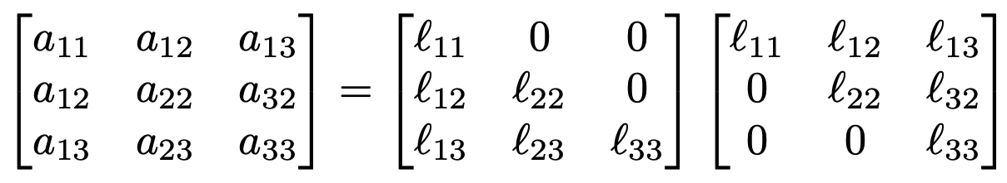
Cholesky Decomposition for Symmetric Matrices
A symmetric matrix A:
Cholesky decomposition for a real, symmetric and positive definite matrix A
Also works for a Hermitian, positive-definite matrix

Slide 80
Matrix L can be computed as follows:

Slide 81
Example: Cholesky Decomposition
We can obtain the following:

Slide 83
Therefore, the L matrix is
The validity can be verified as
LAPACK: DPOTRF computes the Cholesky factorization of a real symmetric positive definite matrix A.

Slide 84
Matrix Eigenvalue
where x and λ are an eigenvector and its corresponding eigenvalue of the matrix, respectively.
Determined from the secular equation:
|A-λI|=0
An n × n matrix has a total of n eigenvalues.

Slide 85
The eigenvalue problem is quite general in physics, which can come from many different problems.
For example, the Lagrange equation for the vibrational modes of a large molecule, or the quantum mechanics Hamiltonian.
In many problems in physics and related fields, the matrix in question is Hermitian with A†=A.

Slide 86
Diagonalization
Diagonalizable matrix:
A square matrix A is called diagonalizable if there exists an invertible matrix P such that P⁻¹AP is a diagonal matrix Λ.
(P diagonalizes A)
A = PΛP⁻¹
Eigen decomposition
Or Spectral decomposition
n×n matrix A is diagonalizable if and only if A has n linearly independent eigenvectors
diagonalizable matrices: normal matrix (including Hermitian matrix, unitary matrix, skew-symmetric matrix)
normal matrix: A^{H} A = A A^{H}

Slide 87
Eigenvalue problem is related to the diagonalization problem

Slide 88
Eigenvalues of a Hermitian matrix
Three important properties:
the eigenvalues are all real;
the eigenvectors can be orthonormal;
can be transformed into a diagonal matrix with the same set of eigenvalues under a similarity transformation of a unitary matrix U.
Similarity transformation: B=P⁻¹AP.
Unitary matrix: P†P=I, P†=P⁻¹; † means the conjugate transpose

Slide 89
Example of matrix diagonalization using LAPACK routine dsyev.f
diatest.f90

Slide 90
Singular Value Decomposition
The SVD was established
for real square matrices in the 1870’s by Beltrami & Jordan
for complex square matrices by Autonne
for general rectangular matrices by Eckart & Young
(autonne-Eckart-Young theorem)
Theorem:
Let . Then there exist orthogonal [unitary] matrices
, , and such that
where
and with

Slide 91
Application of SVD
Data Reduction both variables and observations.
Solving linear least square Problems
Image Processing and Compression.
K-Selection for K-means clustering
Multivariate Outliers Detection
Noise Filtering
Trend detection in the observations and the variables.

Slide 92
Relation between SVD and eigen decomposition
singular values equal to eigenvalues of AA^{T} or A^{T}A

Slide 93
SVD example
Typically, the singular values arranged in decreasing order.
LAPACK: DGESVD computes the singular value decomposition (SVD) of a real M-by-N matrix A, optionally computing the left and/or right singular vectors.

Slide 94
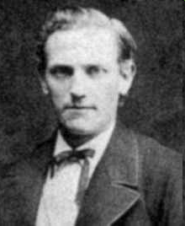
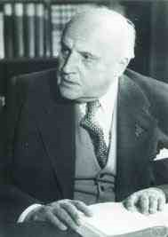
QR Decomposition
Firstly QR decomposition
originated with Gram(1883).
Later Erhard Schmidt (1907)
proved the QR Decomposition
Theorem
Jørgen Pedersen Gram
(1850 –1916)
Erhard Schmidt
(1876-1959)
If A is a m×n matrix with linearly independent columns, then A can be decomposed as , where Q is a m×n matrix whose columns form an orthonormal basis for the column space of A and R is an nonsingular upper triangular matrix.
Uses: widely used to find the eigenvalues of a matrix, to solve linear systems, and to find least squares approximations.

Slide 95
QR Decomposition
Example:
LAPACK:
DGEQRF computes a QR decomposition of a real M-by-N matrix A
ZGEQRF computes a QR decomposition of a complex M-by-N matrix A

Slide 96
Homework
Prove that the time complexity of the Gaussian elimination algorithm is O(N³).
2. Write a general code to transform a n*m matrix into the REDUCED ROW ECHELON FORM, and use the code to obtain the RREF of the following matrix.

Slide 97
3. Solve the 1D Schrodinger equation with the potential (i) V(x)= x²; (ii) V(x)= x⁴ – x² with the variational approach using a Gaussian basis (either fixed widths or fixed centers). Consider the three lowest energy eigenstates.
The Gaussian basis functions are defined as:
This function has two variational parameters: ν_{i}, the width of the Gaussian, and s_{i}, the center of the Gaussian. For simplicity, we only vary one of these parameters at a time and do calculations with either fixed widths or fixed centers.
For integrals of exponential functions, see https://en.wikipedia.org/wiki/List_of_integrals_of_exponential_functions

Slide 98

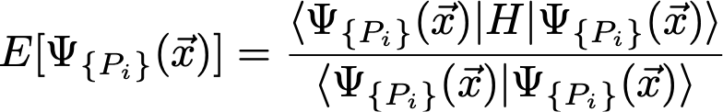


Variational principle
Assume the wave-function depends on a number of adjustable parameters, which can be tuned to minimize the energy expectation value
The minimization is achieved by finding parameters such that the variation of the energy functional, i.e. the first-order change in the energy due to infinitesimal change in any of the parameters vanishes, i.e. for all Pi.
Since the states span only a subspace of the full Hilbert space, energies calculated by this way are always higher than the true eigenvalues. By increasing the size of the subspace, the variational energy gradually approaches the true energy from above — “systematically controllable!”

Slide 99


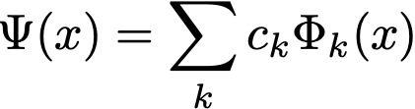
Rayleigh-Ritz variational method
With a complete basis set of orthonormal basis states , any state can be expressed as a linear combination of them

Slide 100
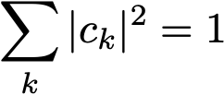
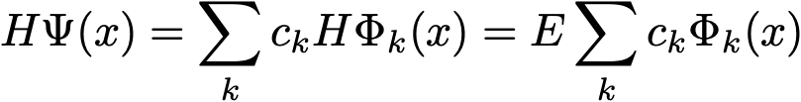

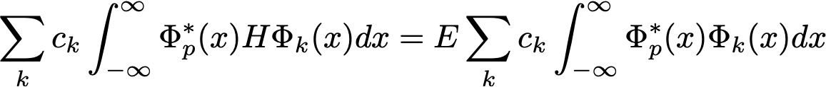
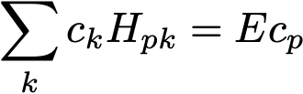
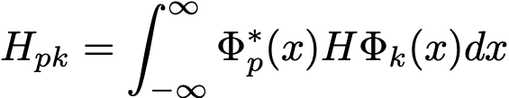

Solving Schrödinger equation using matrix diagonalization
With a complete basis set of orthonormal basis states , any state can be expressed as a linear combination of them
where normalization of implies that
The Schrödinger equation on this orthonormal basis becomes
Multiplying from the right and integrating both terms over x, we have
for every p with
this leads to the matrix of the Schrödinger equation in the next page

Slide 101
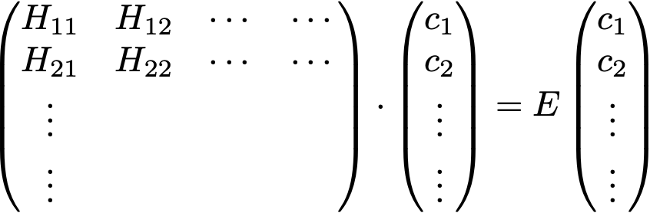

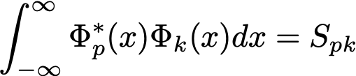
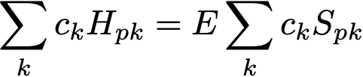
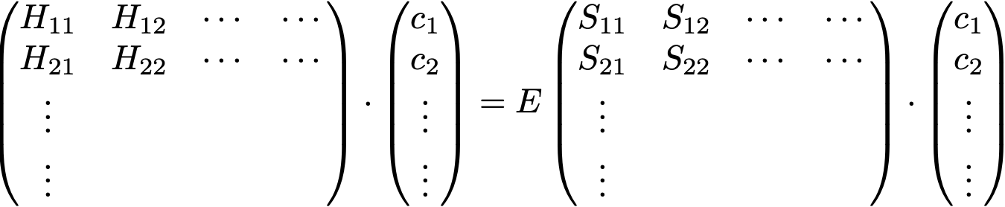
Solving Schrödinger equation using matrix diagonalization
This is the Schrödinger equation expanded on basis set . The solution of the Schrödinger equation corresponds to the eigenvalue of the Hamiltonian matrix
In case the basis set is not orthogonal:
one can show that

Slide 102
Square root of a symmetric matrix

